Slide 1
Process Control (Process state, Process Creation, Termination, Wait, Invoking other Programs and changing size of the process)

Slide 2
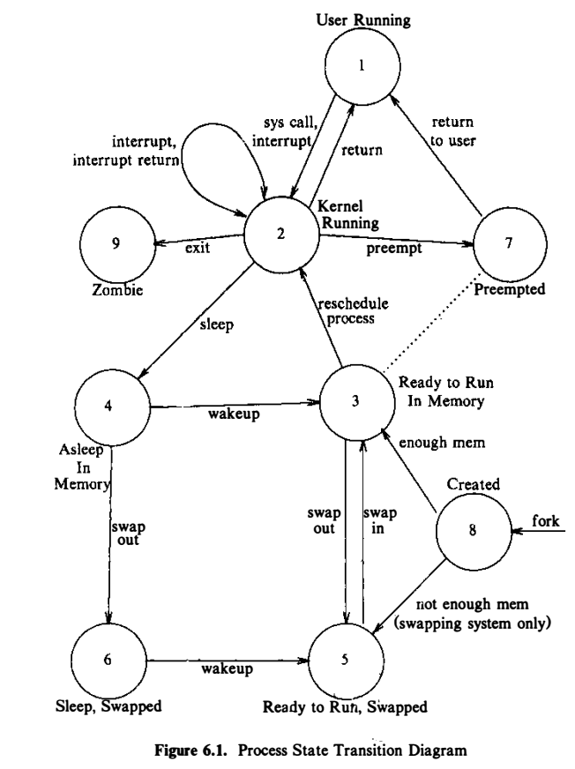
PROCESS STATES AND TRANSITIONS
Process has control over some state transitions at user-level.
A process can create another process
A process can make system calls to move from state "user running" to state "kernel running"
A process can exit of its own volition
Source: The Design of the UNIX Operating System, by Maurice J. Bach

Slide 3
Process States and Transitions
The process is executing in user mode.
The process is executing in kernel mode.
The process is not executing but is ready to run as soon as the kernel schedules it.
The process is sleeping and resides in main memory.
The process is ready to run, but the swapper (process 0) must swap the process into main memory before the kernel can schedule it to execute.
The process is sleeping, and the swapper has swapped the process to secondary storage to make room for other processes in main memory.
The process is returning from the kernel to user mode, but the kernel preempts it and does a context switch to schedule another process.
The process is newly created and is in a transition state; the process exists, but it is not ready to run, nor is it sleeping. This state is the start state for all processes except process 0.
The process executed the exit system call and is in the zombie state. The process no longer exists, but it leaves a record containing an exit code and some timing statistics for its parent process to collect. The zombie state is the final state of a process.

Slide 4
Process states (contd…)
Two kernel data structures describe the state of a process:
Process table entry and
Contains fields that can be accessible to the kernel
u area
Contains fields that need to be accessible only to the running process
The kernel allocates space for the u area only when creating a process
It does not need u areas for process table entries that do not have processes

Slide 5
Process table entry
The state field identifies the process state.
Allow the kernel to locate the process and its u area in main memory or in secondary storage.
used in context switch
Several user identifiers (user IDs or UIDs) determine various process privileges.
For example, the user ID fields delineate the sets of processes that can send signals to each other
Process identifiers (process IDs or PIDs) specify the relationship of processes to each other.
An event descriptor when the process is in the "sleep" state.
Scheduling parameters "kernel running" and "user running."
A signal field enumerates the signals sent to a process but not yet handled
Various timers give process execution time and kernel resource utilization, used for process accounting and for the calculation of process scheduling priority

Slide 6
u area
A pointer to the process table identifies the entry that corresponds to the u area.
The real and effective user IDs determine various privileges allowed the process, such as file access rights
Timer fields record the time the process (and its descendants) spent executing in user mode and in kernel mode.
An array indicates how the process wishes to react to signals.
The control terminal field identifies the "login terminal" associated with the process, if one exists.
An error field records errors encountered during a system call.
A return value field contains the result of system calls.
I/O parameters describe the amount of data to transfer, the address of the source (or target) data array in user space, file offsets for I/0, and so on.
The current directory and current root describe the file system environment of the process.
The user file descriptor table records the files the process has open
Limit fields restrict the size of a process and the size of a file it can write .
A permission modes field masks mode settings on files the process creates.

Slide 7
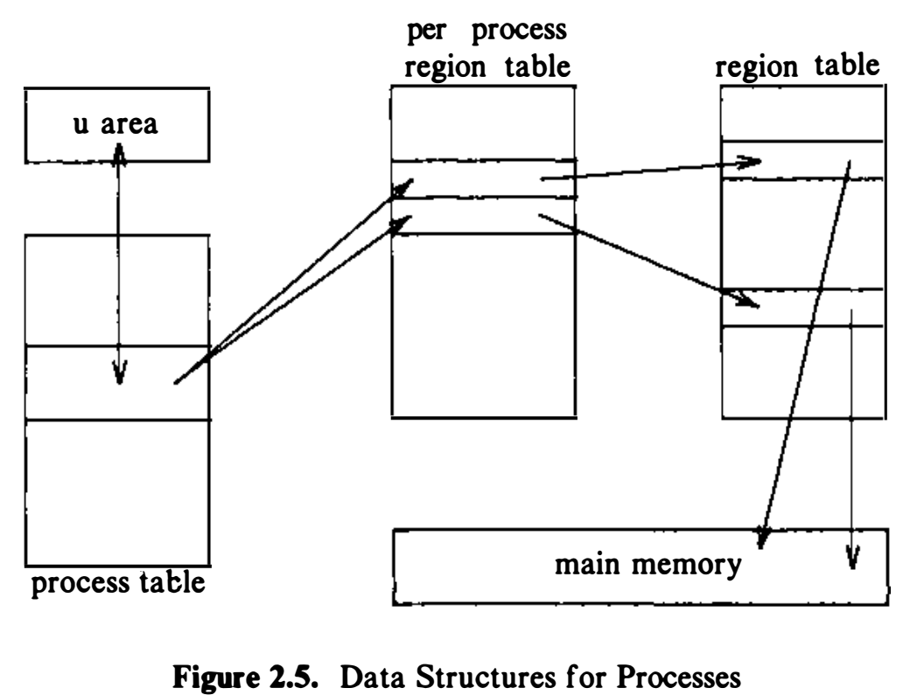
Data structure for Process
Source: The Design of the UNIX Operating System, by Maurice J. Bach

Slide 8
Process Context
Consists of the
Contents of its (user) address space and
The contents of hardware registers and
Kernel data structures that relate to the process.
The author defines context of a process as union of:
User-level context
Register context
System-level context

Slide 9
Process Context (contd…)
The user-level context consists of
The process text, data, user stack, and shared memory that occupy the virtual address space of the process.
Parts of the virtual address space of a process that periodically do not reside in main memory because of swapping or paging.

Slide 10
Process Context (contd…)
The register context:
The program counter
The address is a virtual address in kernel or in user memory space.
The processor status register (PS)
The stack pointer contains the current address of the next entry in the kernel or user stack,
The general-purpose registers contain data generated by the process during its execution.

Slide 11
Process Context (contd…)
The system-level context
"static part" and
a "dynamic part": viewed as a stack of context layers
Static part
The process table entry of a process defines the state of a process, and contains control information
The u area of a process contains process control information that need be accessed only in the context of the process.
Pregion entries, region tables and page tables, define the mapping from virtual to physical addresses and therefore define the text, data, stack, and other regions of a process.

Slide 12
Process Context (contd…)
The kernel stack contains the stack frames of kernel procedures as a process executes in kernel mode.
Although all processes execute the identical kernel code, they have a private copy of the kernel stack that specifies their particular invocation of the kernel functions.
For instance,
One process may invoke the creat system call and go to sleep waiting for the kernel to assign a· new inode,
Another process may invoke the read system call and go to sleep awaiting the transfer of data from disk to memory.
Both processes execute kernel functions, but they have separate stacks that contain their private function call sequence. The kernel must be able to recover the contents of the kernel stack and the position of the stack pointer to resume execution of a process in kernel mode.
System implementations frequently place the kernel stack in the process u area, but it is logically independent and can exist in an independently allocated area of memory.
The kernel stack is empty when the process executes in user mode.

Slide 13
Process Context (contd…)
Dynamic part
The kernel stack contains the stack frames of kernel procedures as a process executes in kernel mode.
The dynamic part of the system-level context of a process consists of a set of layers, visualized as a last-in-first out stack.

Slide 14
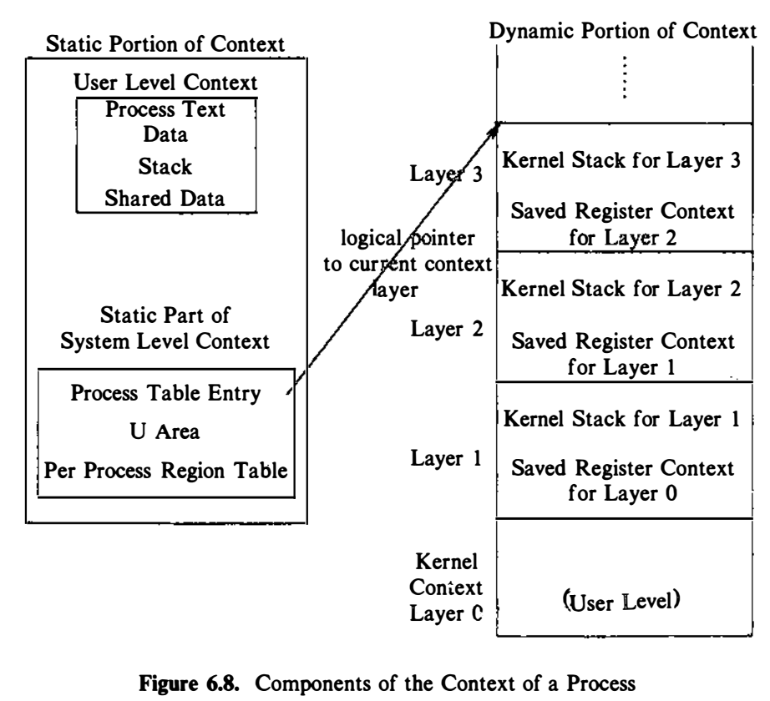
Process Context (contd…)
dummy layer that represents the user-level context
Source: The Design of the UNIX Operating System, by Maurice J. Bach

Slide 15
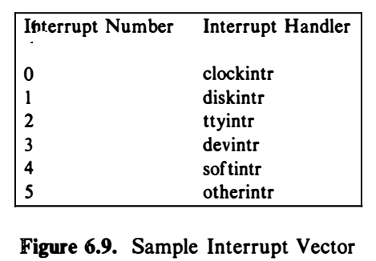
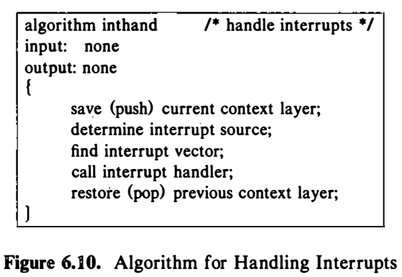
Process Context (contd…)
Source: The Design of the UNIX Operating System, by Maurice J. Bach

Slide 16
Process Creation: fork()
To create a new process we need to invoke the system call fork ().
Parent process: process that invokes fork
Child process: the newly created process
fork takes no arguments and returns a process ID
pid = fork();
If fork() returns a negative value, the creation of a child process was unsuccessful.
fork() returns a zero to the newly created child process.
fork() returns a positive value, the process ID of the child process, to the parent.
Process 0, created internally by the kernel when the system is booted, is the only process not created via fork.

Slide 17
Process Creation : fork() (contd…)
The kernel does the following sequence of operations for fork.
It allocates a slot in the process table for the new process.
It assigns a unique ID number to the child process.
It make an logical copy of the parent's address space and give it to the child. Therefore, the parent and child processes have separate address spaces.
It increments file and inode table counters for files associated with the process.
It returns the ID number of the child to the parent process, and a 0 value to the child process.

Slide 18
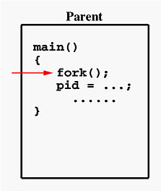
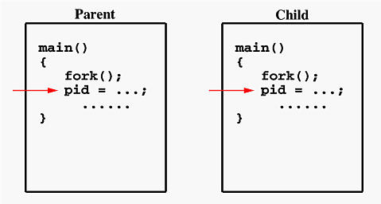
Example: fork()

Slide 19
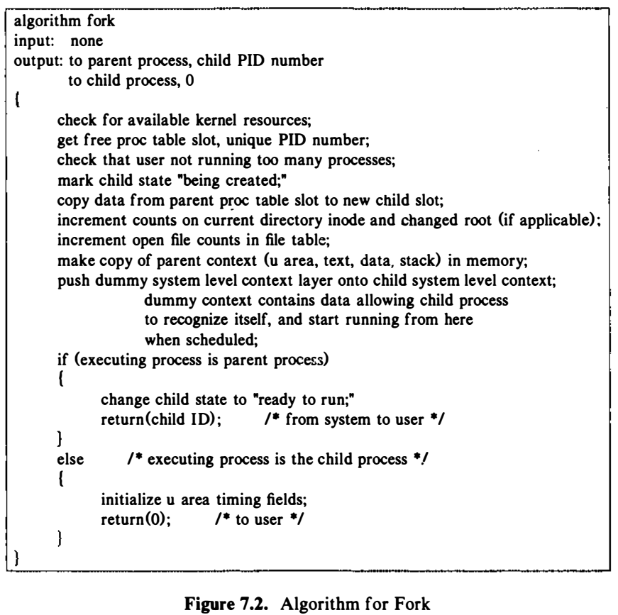
Source: The Design of the UNIX Operating System, by Maurice J. Bach

Slide 20
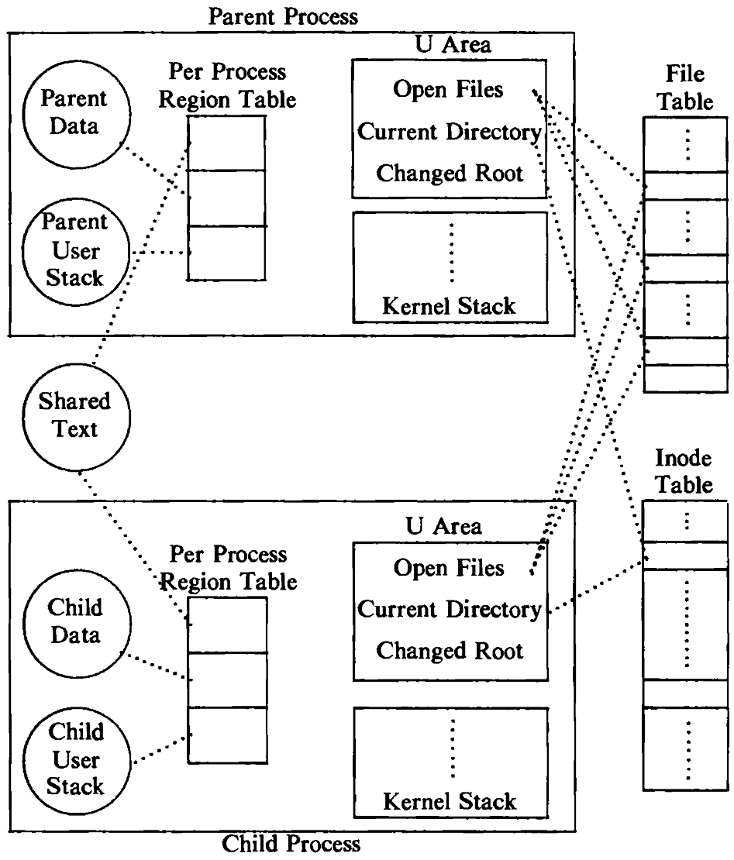
Process Creation (contd…)
The kernel makes a copy of the parent context for the child process, and the parent process executes in one address space and the child process executes in another.
Source: The Design of the UNIX Operating System, by Maurice J. Bach
Figure 7.3. Fork Creating a New Process Context

Slide 21
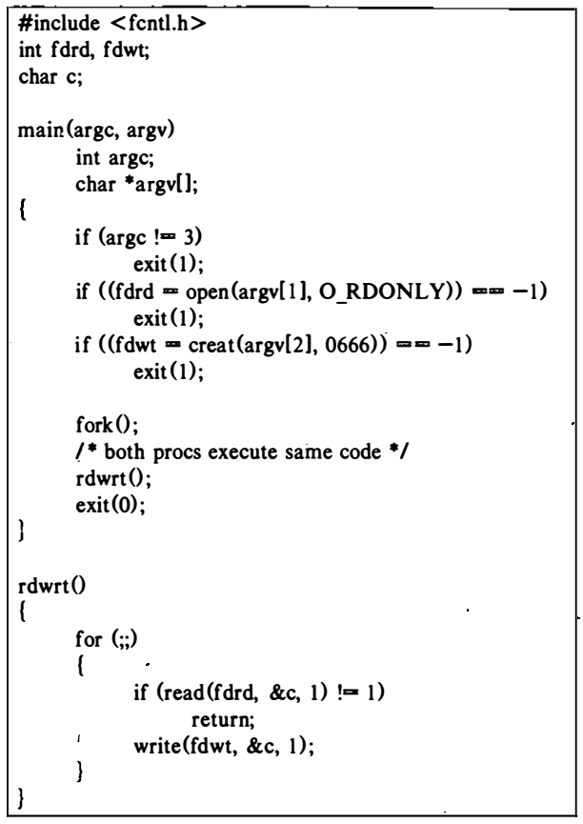
Example: fork

Slide 22
Process Termination
Processes terminate by executing the exit system call.
An exiting process enters the zombie state,
relinquishes its resources, and
dismantles its context except for its slot in the process table.
exit (status);
The value of status is returned to the parent process for its examination.
Processes may call exit explicitly or implicitly at the end of a program.

Slide 23
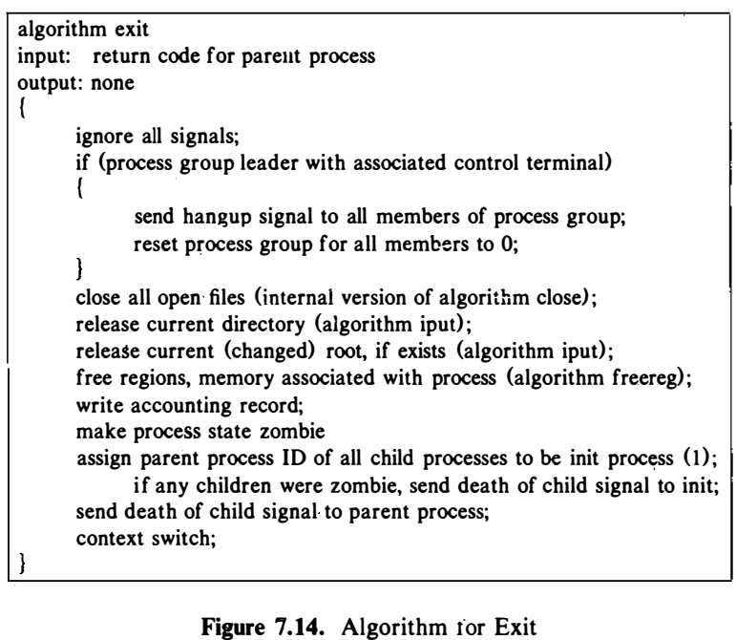
Process Termination
Source: The Design of the UNIX Operating System, by Maurice J. Bach

Slide 24
Process Termination
When any of the children are zombie,
The exiting process sends "death of child" signal so that init can remove them from the process table.
The exiting process sends its parent a "death of child" signal, too.
In the typical scenario, the parent process executes a wait system call to synchronize with the exiting child.
The now-zombie process does a context switch so that the kernel can schedule another process to execute
The kernel never schedules a zombie process to execute.

Slide 25
Awaiting Process Termination
A process can synchronize its execution with the termination of a child process by executing the wait system call.
pid = wait(stat addr);
pid is the process ID of the completed process, and
stat_addr is the address in user space that will contain the exit status code of the child.

Slide 26
Awaiting Process Termination
Blocks the calling process until one of its child processes exits or a signal is received
The kernel (wait()) searches for a zombie child of the process and, if there are no children, returns an error.
If it finds a zombie child,
It extracts the PID number and the parameter supplied to the child's exit call
Returns those values from the system call.
Finally, releases the process table slot formerly occupied by the zombie process.
The slot is now available for a new process

Slide 27
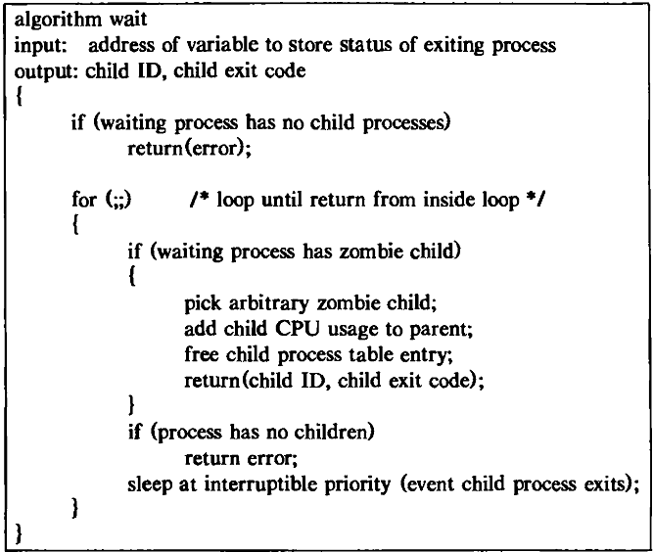
Awaiting Process Termination
If the process executing wait has child processes but none are zombie, it sleeps at an interruptible priority until the arrival of a signal.
Source: The Design of the UNIX Operating System, by Maurice J. Bach
Fig: Algorithm for Wait

Slide 28
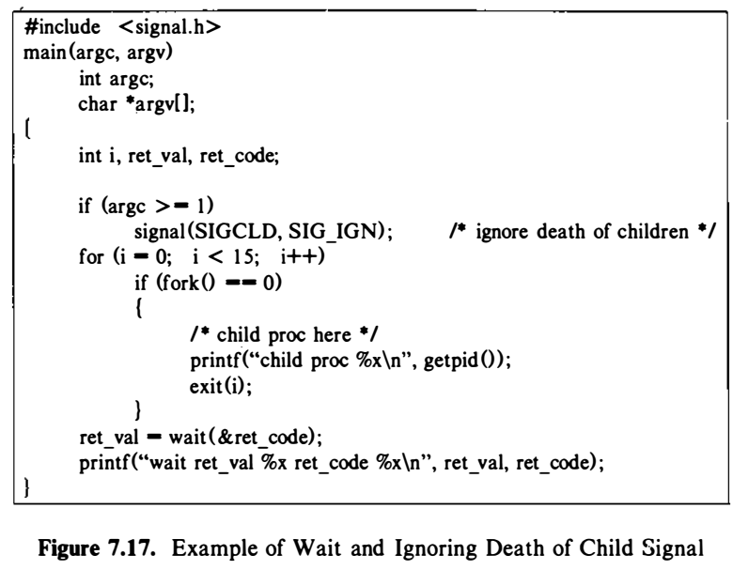
Wait: Example (1)

Slide 29
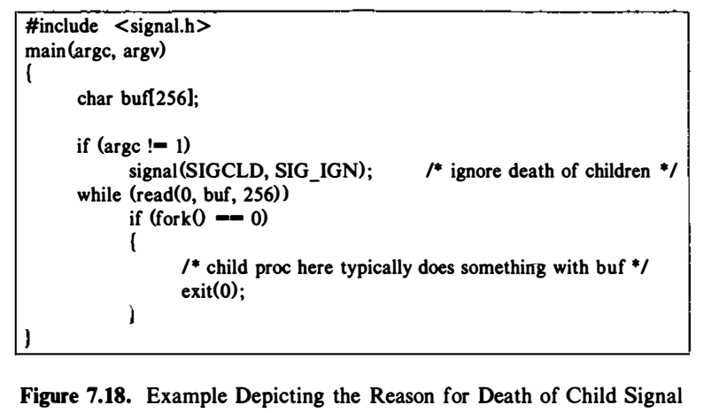
Wait: Example (2)

Slide 30
Invoking other Programs
Can a process invoke the other program?
The created child process does not have to run the same program as the parent process does.
The exec system call used to invokes other programs.
Replace the old program with a new program.
The entire content of the process is replaced with a new program.
The exec system call is used to execute a file which is residing in an active process. When exec is called the previous executable file is replaced and new file is executed.

Slide 31
Invoking other Programs
The exec system calls allow a process to run any program files.
The exec system call invokes another program, overlaying the memory space of a process with a copy of an executable file.
execve(filename, argv, envp)
filename is a character string that contains the name of a file to be executed.
argv is a pointer to an array of character pointers that are parameters to the executable program, and
envp is a pointer to an array of character pointers that are the environment of the executed program.
The first argument will be loaded into the caller's address space and over-write the program there

Slide 32
Invoking other Programs
The new program is loaded into the same process space.
The current process is just turned into a new process
The process id PID is not changed, this is because we are not creating a new process we are just replacing a process with another process in exec.
The data, code, stack, heap, etc. of the process are changed and are replaced with those of newly loaded process.
The new process is executed from the entry point.

Slide 33
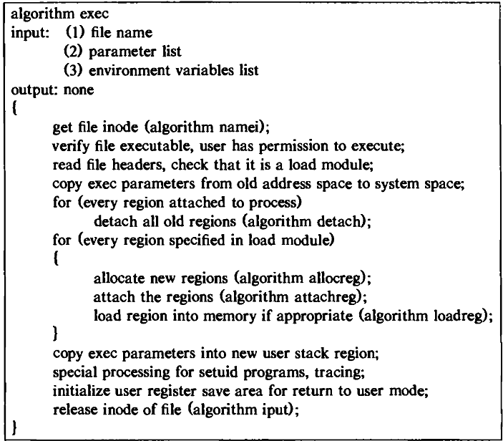
Invoking Other Programs
Exec first accesses the file via algorithm namei to determine if it is an executable, regular (non-directory) file and to determine if the user has permission to execute the program.
The kernel then reads the file header to determine the layout of the executable file.
Source: The Design of the UNIX Operating System, by Maurice J. Bach
Fig: Algorithm for Exec

Slide 34
Invoking other Programs
Exec system call is a collection of functions in C programming language, the standard names for these functions are:
execl, execv, execle, execve, execlp and execvp
All these functions have the same base exec followed by one or more letters.
Header file: #include <unistd.h>

Slide 35
Invoking other Programs
execl, execv, execle, execve, execlp and execvp
e: It is an array of pointers that points to environment variables and is passed explicitly to the newly loaded process.
l: l is for the command line arguments passed a list to the function.
p: p is the path environment variable which helps to find the file passed as an argument to be loaded into process.
v: v is for the command line arguments. These are passed as an array of pointers to the function.

Slide 36
Invoking other Programs
int execl(file_name, arg0 [, arg1, ..., argn], NULL)
char *file_name, *arg0, *arg1, ..., *argn;
int execv(file_name, argv)
char *file_name, *argv[];
int execle(file_name, arg0 [, arg1, ..., argn], NULL, envp)
char *file_name, *arg0, *arg1, ..., *argn, *envp[];
int execve(file_name, argv, envp)
char *file_name, *argv[], *envp[];
int execlp(file_name, arg0 [, arg1, ..., argn], NULL)
char *file_name, *arg0, *arg1, ..., *argn;
int execvp(file_name, argv)
char *file_name, *argv[];

Slide 37
Invoking other Programs
file_name names the executable binary file to be transformed into a process.
arg0 and argv define the arguments to be passed to the process, and envp defines the environment, also to be passed to the process.
arg0 and argv[0] name the last path name component of the executable binary file named by file_name.
For execl(), execv(), execle(), and execve(), file_name must be the fully qualified path name of the executable binary file.
However for execlp() and execvp(), the PATH variable is used to find the executable binary file.

Slide 38
Invoking other Programs
When the environment is not explicitly given as an argument to an exec system call, the environment of the current process is used.
The last array element of both argv and envp must be null to signify the end of the array.

Slide 39
Invoking Other Programs
There are several library functions that call the exec system call such as execl, execv, execle, and so on.

Slide 40
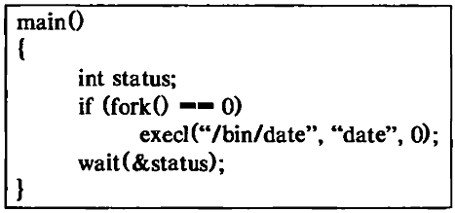
Use of Exec
The program creates a child process that invokes the exec system call.
Immediately after the parent and child processes return from fork, they execute independent copies of the program.
Source: The Design of the UNIX Operating System, by Maurice J. Bach

Slide 41
Use of Exec
When the child process is about to invoke the exec call, its text region consists of the instructions for the program, its data region consists of the strings "/bin/date" and "date", and its stack contains the stack frames the process pushed to get to the exec call.
Source: The Design of the UNIX Operating System, by Maurice J. Bach

Slide 42
Use of Exec
The kernel finds the file “/bin/date" in the file system, finds that all users can execute it, and determines that it is an executable load module.
The kernel copies the strings “/bin/date " and "date" to an internal holding area and frees the text, data, and stack regions occupied by the process.
Source: The Design of the UNIX Operating System, by Maurice J. Bach

Slide 43
Use of Exec
The kernel allocates new text, data, and stack regions for the process, copies the instruction section of the file “/bin/date" into the text region, and copies the data section of the file into the data region.
Source: The Design of the UNIX Operating System, by Maurice J. Bach

Slide 44
Use of Exec
After the exec call, the child process no longer executes the old program but executes the program "date": When the "date" program completes, the parent process receives its exit status from the wait call.

Slide 45
Advantages of separate regions for text and data
Two advantages for keeping text and data separate:
Protection and
Sharing
If text and data were in the same region, the system could not prevent a process from overwriting its instructions,
It would not know which addresses contain instructions and which contain data.
If text and data are in separate regions, the kernel can set up hardware protection mechanisms to prevent processes from overwriting their text space.

Slide 46
Advantages of separate regions for text and data
Sharing
If a process cannot write its text region, its text does not change from the time the kernel loads it from the executable file.
If several processes execute a file they can, therefore, share one text region, saving memory.
When the kernel allocates a text region for a process in exec, it checks if the executable file allows its text to be shared, indicated by its magic number.

Slide 47
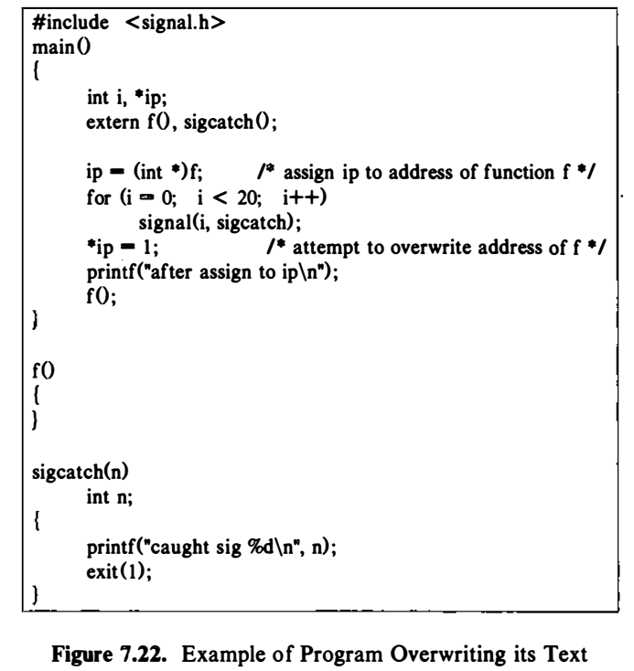
Advantages of separate regions for text and data: Example

Slide 48
User ID of a Process
Two user IDs with a process,
The real user ID: Independent of the process ID
The effective user ID or setuid (set user ID)
The real user ID identifies the user who is responsible for the running process.
The effective user ID
To assign ownership of newly created files,
To check file access permissions,
To check permission to send signals to processes via the kill system call.

Slide 49
User ID of a Process
The kernel allows a process to change its effective user ID
When it execs a setuid program
When it invokes the setuid system call explicitly
A setuid program is an executable file
The setuid bit set in its permission mode field.
The kernel sets the effective user ID fields in the process table and u area to the owner ID of the file.

Slide 50
User ID of a Process
setuid(uid)
where uid is the new user ID, and its result depends on the current value of the effective user ID.
Superuser?

Slide 51
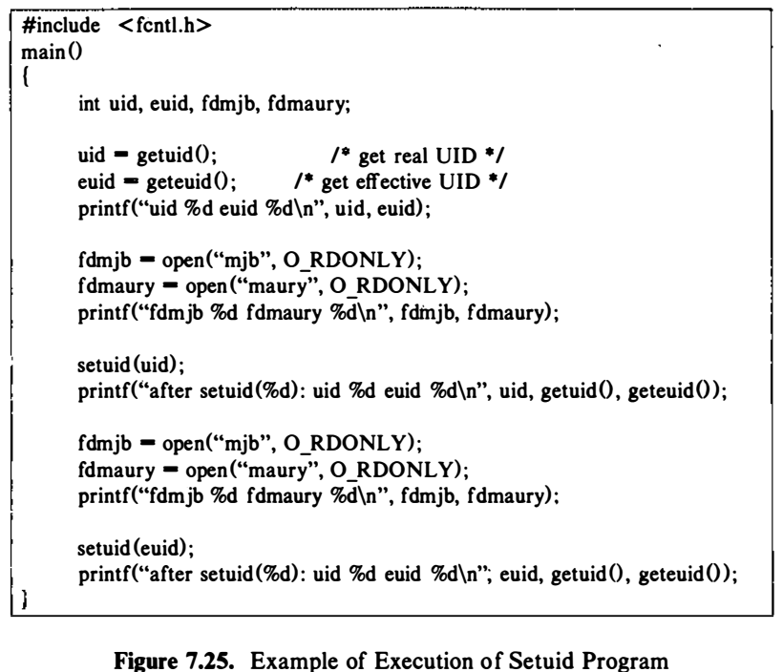
User ID of a Process: An example
Suppose the executable file produced by compiling the program has owner "maury" (user ID 8319),
Its setuid bit is on,
All users have permission to execute it.
Assume that users "mjb" (user ID 5088) and "maury" own the files of their respective names, and that both files have read-only permission for their owners

Slide 52
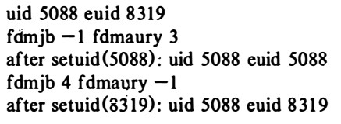
User ID of a Process: An example
User “mjb" sees the following output when executing the program:

Slide 53
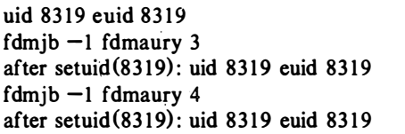
User ID of a Process: An example
User "maury" sees the following output when executing the program:

Slide 54
User ID of a Process
The login program executed by users when logging into the system is a typical program that calls the setuid system call.
Login is setuid to root (supcruser) and therefore runs with effective user ID root.

Slide 55
Changing the Size of a Process
A process may increase or decrease the size of its data region
int brk(endds)
The endds becomes the value of the highest virtual address of the data region of the process (called its break value).
void *sbrk(int increment)
Where increment changes the current break value by the specified number of bytes.
If the data space of the process increases as a result of the call, the newly allocated data space is virtually contiguous to the old data space

Slide 56
Changing the Size of a Process
Return value
on success, brk() returns zero,
in case of error, -1 is returned
The kernel checks that the new process size is less than the system maximum and that the new data region does not overlap previously assigned virtual address space.
If all checks pass, the kernel invokes growreg to allocate auxiliary memory for the data region and increments the process size field.
If there is no room in memory, it swaps the process out to get the new space

Slide 57
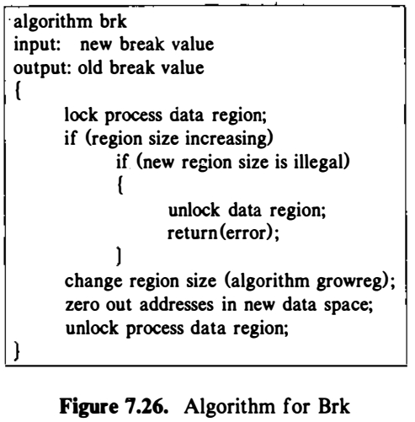
Changing the Size of a Process
Source: The Design of the UNIX Operating System, by Maurice J. Bach

Slide 58
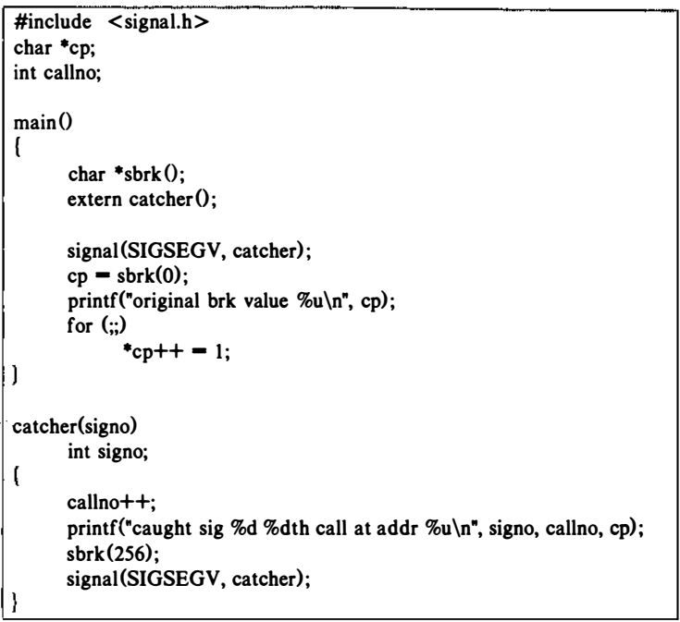
Changing the Size of a Process: Example

Slide 59
Reference
The Design of the UNIX Operating System, by Maurice J. Bach

